Slide 1


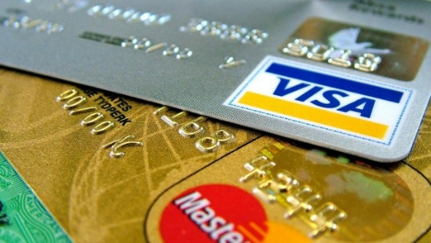
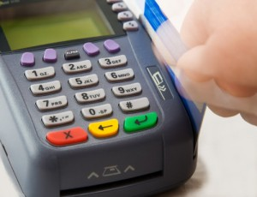
DirectLink Capital Corporation
Merchant Solutions-Processing and Equipment

Slide 2
Why DirectLink Capital Equipment and Processing?
Most processing companies use the “Gillette” way of doing business.
This business “gives away the equipment” but make it up on processing and residual supplies.
Today people have become more cost conscious and asking for discounts
Quite simply, those discounts are NOT BIG ENOUGH!
DLCC through Red Payment Systems, guarantees you the LOWEST PROCESSING FEES and with a LIFETIME GUARANTEE NOT TO GO UP

Slide 3

Merchant Equipment – Plan A
VX 520 Lease (or other equipment)
Lease for $49.99/mo to $129.99/mo
Merchant Pay Program
This is how we make our money
We provide FREE SUPPLIES during the lease
Most companies use the Gillette Way to Sell
They give you the equipment
BUT you overpay for the processing

Slide 4
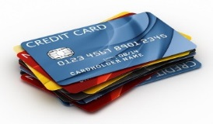
Credit Card Processing

Slide 5
Processing Fees – PLAN A
Lets say you have $20,000 of Merchant Transactions Monthly
Your average order is $50.00 (400 transactions monthly)
Your current plan is 1.5% (most are more)
You currently pay $300.00 to the processing company.
OUR PLAN:
You pay 6 cents per transaction and 1/10% on total volume
This is $24.00 plus $20.00 = $45.00 monthly
Minimum is $25.00

Slide 6
Compare Plans 4000 transactions@$10.00=$40,000 monthly
Showing previous example This shows typical restaurant with 3 machines
PLAN | CURRENT | PROPOSED | CURRRENT (1.5%) | PROPOSED
EQUIPMENT FEES | $0.00 | $59.99 | $0.00 | $179.97
PROCESSING | $300.00 | $45.00 | $600.00 | $280.00
YOUR COST MONTHLY | $300.00 | $104.99 | $600.00 | $459.97
TOTAL SAVINGS USING OUR PLAN |  | $195.01/MO |  | $140.03/MO

Slide 7
COMPARISON
A SMALL BUSINESS OWNER SAVES $1,200.00 TO $6,000.00 A YEAR
This savings is AFTER the cost of the lease
PLUS Free Supplies
PLUS Upgrades during Lease for Compliancy
PLUS 24/7 LIVE support
PLUS personal service agent who lives in your area!
Most Medium sized businesses (grocery stores, etc) save $10,000.00 to $100,000.00 a year after equipment lease!

Slide 8
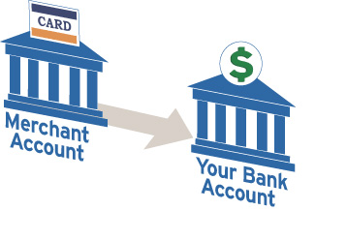
NEW PLAN OF THE FUTURE
STOP PAYING MERCHANT FEES. START EARNING MONEY FOR PROCESSING

Slide 9
Merchant Equipment – PLAN B
Imagine paying NO PROCESSING FEES?
Our new program and new laws allows a small convenience fee charged per transaction to the customer.
Our software can be loaded with YOUR CHOICE
Choose to pay processing fees like Plan A OR
Choose 0 fees and we program your processing fees to charge your customers just like a tax.
This program is perfect for businesses that have chosen NOT to use credit cards. NOW you can have those customers at NO COST TO YOU!

Slide 10
PLAN B (Equipment Lease Only)
NO MERCHANT PROCESSING FEES!
This plan is for businesses doing at least $10,000 volume per machine per month. Most restaurants and grocery stores qualify for this plan.
We lease you equipment with all of the benefits previously mentioned (free supplies, 24/7 live service, etc.)
All batch fees, merchant fees, statement fees are 0!
Customer is now charged a small convenience fee (0.39 per 10.00)
All merchant pays is the lease (79.99 – 209.99/mo)

Slide 11
COMPARISON
Example 1 uses $60,000 a month and leasing 2 machines @ 89.99
Example 2 uses $400,000 a month gross volume such as a typical grocery store and leasing 8 machines
(Assumptions that current plan has a 1.5% processing fee)
Merchant 0 fee with customer convenience tax program
PLAN B | CURRENT | PROPOSED | CURRENT | PROPOSED
Lease | $0.00 | 189.95 | 0 | 719.92
Processing fees | $900.00 | 0 | $6,000.00
TOTAL | $900.00 | 189.95 | $6,000.00 | 719.92
SAVINGS |  | 710.05/MONTH |  | 5280.08/MONTH

Slide 12
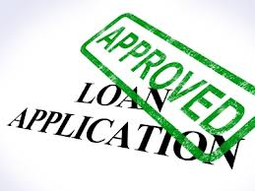


Merchant Solution 2 - Loans

Slide 13
Why DirectLink Capital Loans?
DirectLink Capital Corporation has Agreements with more than 800 Merchant Capital Lenders.
DirectLink Capital (DLCC) does enough volume to get you the best chance for approval at the least cost based on your personal situation.
DLCC has the capability to get you short term loans fast and/or more complex loans such as SBA Loans and Real Estate Loans Streamlined
DLCC has private sources of capital
The Executives of DLCC spent more than 30 years experience in Lending including Wells Fargo and other major companies
In most cases, the lender pays DLCC. The loan cost is the same or less than if you applied online yourself.

Slide 14
MERCHANT LOANS
Unsecured
Flexible: daily or weekly pay. Based on your sales
Credit Scores from 450 to 800 qualify
Good Credit in Preferred Businesses (Restaurants, Professional, Grocery Stores, Healthcare) qualify for Preferred Rate Loans
Problem getting credit? No problem. Our line of credit works on a relationship basis. You start with a modest line of credit to meet basic needs which goes up as you build your relationship (and credit score) and your rate goes down as well.
Loans up to $5,000,000 based on Gross Sales (10% to 15%)

Slide 15
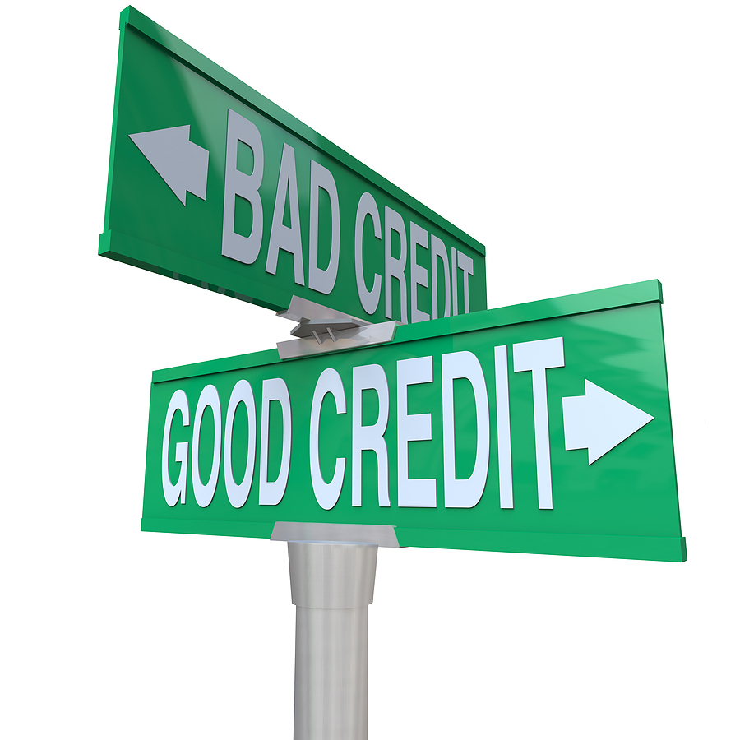
LINES OF CREDIT
Up to $5,000,000.00
Up to 5 years
Personalized Lines
A+ Rated Companies Only

Slide 16
Lines of Credit
We get 79% of our lines of credit approved!
Based on Gross Sales
24 hour approval and Funding within 48 hours.
Initial Paperwork: One page App and six months bank statements
Credit Lines start at 10% of gross sales
Starting Time Frame is 6 months to one year
After 4 months you will increase line and interest rate drops.
Credit line after 4 months is up to $5,000.000 and up to 5 years

Slide 17
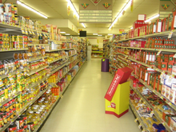

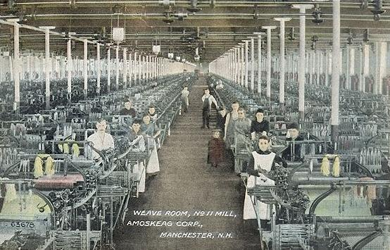
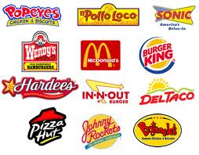
Preferred Rate Lines
Industry Specific
Rates as Low as 7.99%
No Upfront Cost
No Prepayment Penalties
Simple Interest Calculation
Good Credit Scores Only

Slide 18
Preferred Rate Lines
Minimums 2 years in business
Credit Score Minimum of 640 to 660 (depending on business)
Qualified Businesses (Healthcare, Restaurants, Grocery Stores, Manufacturing, Professional, and certain other businesses)
Rates as low as 7.99% SIMPLE INTEREST (Most merchant loans use a factor which is a more expensive true APR)
NO UPFRONT FEES and NO PREPAYMENT PENALTY
Approval in 48 hours or less and funding within 24 hours from approval time

