Slide 1

DIRECTLINK CAPITAL CORPORATION

Slide 2
DIRECTLINK CAPITAL CORPORATION
Empowering the BEST and MOST INNOVATIVE products and ideas to Commercial Borrowers and Merchants

Slide 3
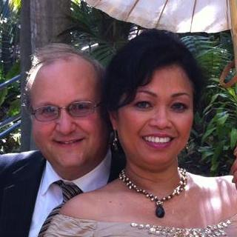
Meet the Team
Keith Goodman and Eva Salsbury Co-Founders Sr. VP and Secretary
Keith Goodman and Eva Salsbury founded DLCC in 2012. Mr. Goodman spent most of his 40+ years in the Financial Industry. Mr. Goodman began his professional career at Beneficial Finance. After two years moved into dealer and commercial financing for ITT.
In 1984 Mr. Goodman started in Financial planning and investment banking lasting more than 25 years. Most of this time was with Wachovia (now Wells Fargo) as Vice President. Mr. Goodman worked with many HNW individuals and institutions.

Slide 4
Meet the Team
Stephen Tharp – CFO and Co-Founder
Mr. Tharp, a graduate of Ohio State University spent most of his life in the financial and insurance industries.
Stephen Tharp worked for several years in HR and Employee Relations.

Slide 5
Key Members
Randy King – Vice President
Randy is primarily responsible for loan qualification and pre-underwriting as well as packaging. Randy worked for Edward Jones and also owned an insurance company. Randy has been an integral part of the growth of DLCC
Bruce Arnoff – Vice President Commercial Lending and Credit Card Processing.
Bruce responsibilities includes sales training his team, loan submissions, and credit card processing. Bruce has been involved in sales over 30 years.

Slide 6
Key Personnel
John Rakityan – National Sales Manager
John has already brought more than 15 agents to DLCC and will be a key part to the growth of DLCC moving forward. John has more than 20 years sales management experience.
Trey Shelton – National Marketing Director
Trey has extensive experience in the Commercial Construction business. His team primarily is responsible for loan origination on new commercial construction projects. Trey also has a staff which works with credit card processing

Slide 7
Key Staff Members and Affiliates
Mark Belinky – Internal Legal for Equity PPM and Portal Management
Mark’s legal career extends more than 30 years including probate judge
Craig Evans – President RECS.
Craig is our primary consulting source for Alternative Energy Projects and obtaining Grants and Capital
Glenn and Stacey Johnson –
Glenn is responsible for our recruiting and personnel.
Glenn has more than 40 years experience in Recruiting

Slide 8
DLCC Account Executives
Brian Kochunas (Youngstown and Warren OH)
Daryl Seabolt (Atlanta GA)
Robin Fry (Pittsburgh PA)
Larry Maola (Sharon PA)
Donna Rutherford (Omaha NE)
Alex Kline (Las Vegas NV)
Martin Kuzel (Chicago IL)
Andrew Davis (Columbus OH)
Shelley Battenfield (Cincinnati OH)
Daniel Bennett (Blackshear GA)

Slide 9
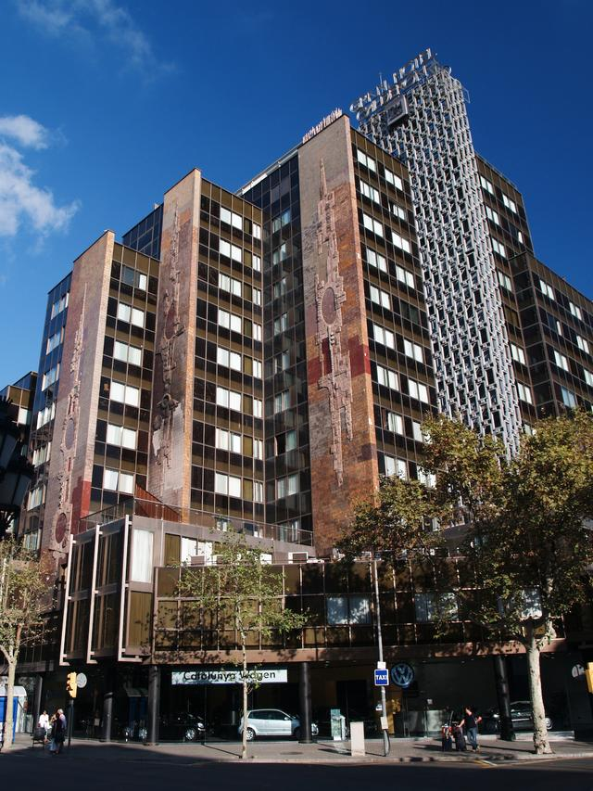
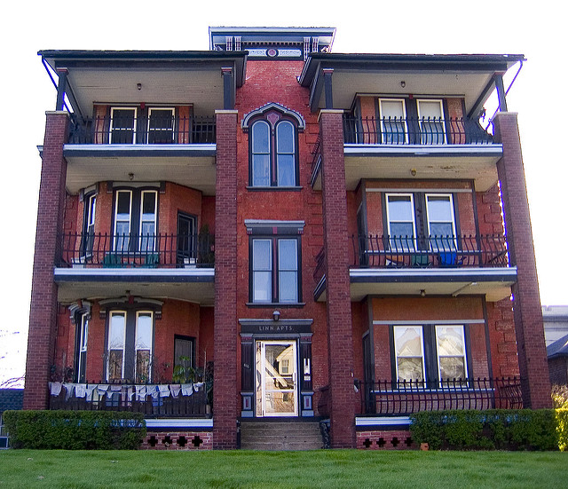
COMMERCIAL REAL ESTATE LOANS
Multi Family Project Special Rates

Slide 10
MULTI FAMILY SPECIALS
Non- Recourse
Multi Family Special (up to 15% mixed use allowed)
Current Rate* 4.375% (plus .65% PMI)
In most cases 85% LTV
35 Years Amortization
Uses include REFI, New Construction, Purchase
Bridge Loans Available to start project earlier

Slide 11
Multi Family Housing Financing
HUD Loan with 75% or more assistance
90% LTV or LTC
Purpose is New Construction and Limited Scope
Rate 4.25% (subject to change)
Non- Recourse
40 Year Amortization

Slide 12
Non HUD or FHA Financing
Non HUD or FHA Financing
Current rate 5%
Up to 80% LTV or LTC
Non-Recourse
Not limited to Multi-Family
May qualify for some mixed use Real Estate
Other loans with flexible terms available
Used as Bridge Substitute if qualified

Slide 13
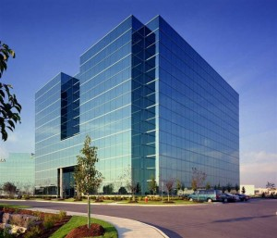
DLCC COMMERCIAL FINANCING

Slide 14
DLCC COMMERCIAL LENDING
DLCC connects borrowers through a network of more than 1000 lenders.
These lenders include special bank financing
Insurance companies
Private Hedge Funds
Other Non-Conventional Financing

Slide 15
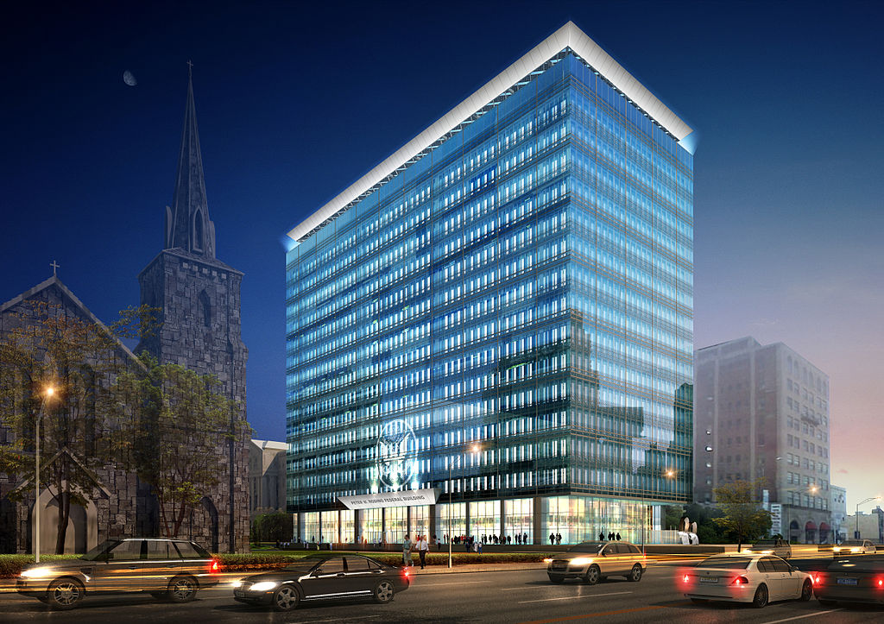
DLCC Real Estate Financing
Office Buildings

Slide 16
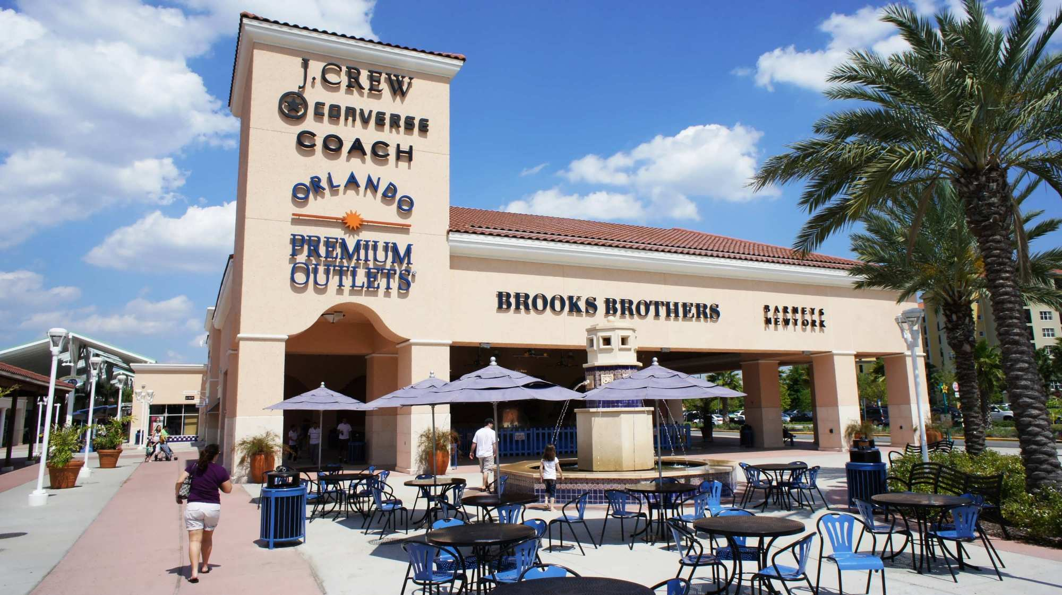
DLCC Real Estate Financing
Retail Strip Centers and Outlet Stores

Slide 17
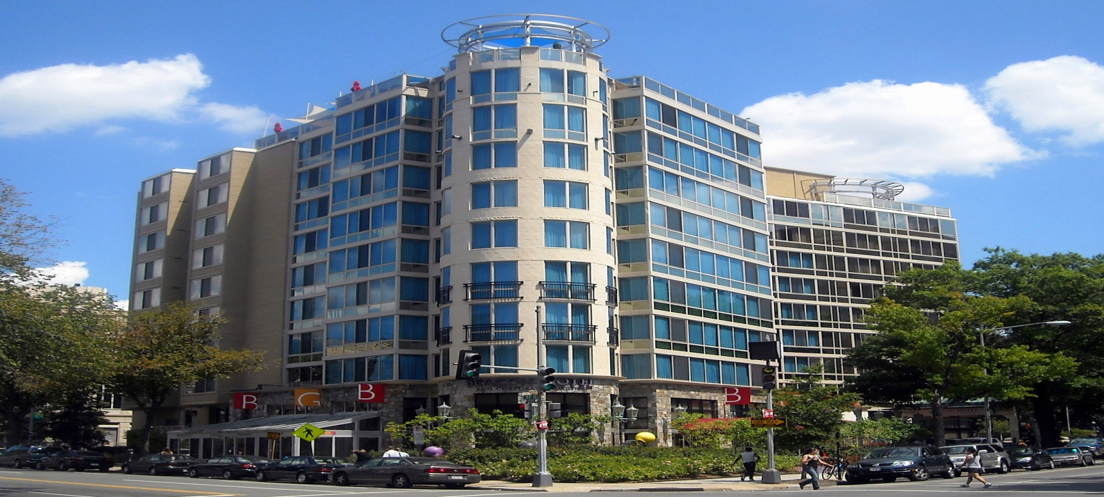
DLCC Commercial Financing
Hotels

Slide 18
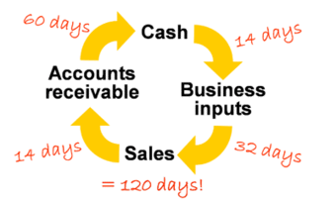
WORKING CAPITAL LOANS

Slide 19




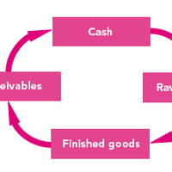

WORKING CAPITAL USES

Slide 20
Purpose of Working Capital Loans
Pay off Debt
Payroll
Marketing and Advertising
Equipment Purchase
General Expenses
Cover Slow Months
Inventory Purchase* (Limited to certain industries)

Slide 21

DLCC SBA Working Capital Loans
NEW SBA Working Capital Loans
DLCC though our partners are able to provide an SBA Working Capital loan for your needs less expensive than other choices of working capital loans. DLCC has the most unique online process.
Pre-qualification process takes 15 minutes (5 minutes for answer) PRE-QUALIFY NOW

Slide 22
NEW SBA Working Capital Loans
Minimum 650 credit score, no delinquencies, 2+ years in business, no tax liens or criminal record
7% (8.53% including fees) Rate. 8% on smaller amounts
Payment on $100,000 is $1,162 per month
Payoff your high interest working capital loan
No prepayment penalty
Requirements can be discussed with our qualified agents

Slide 23

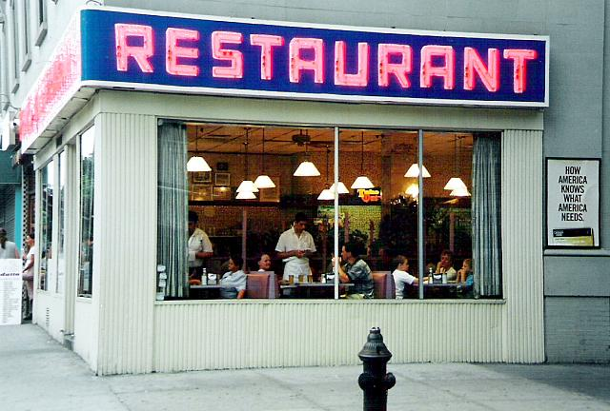
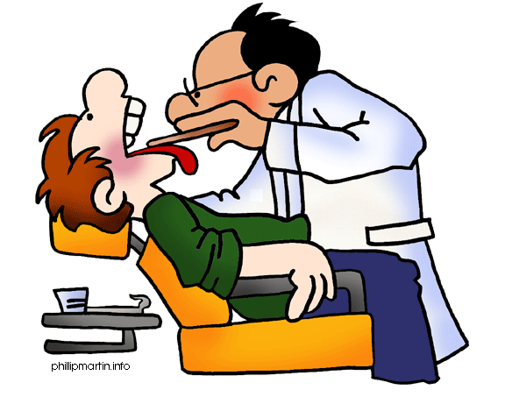

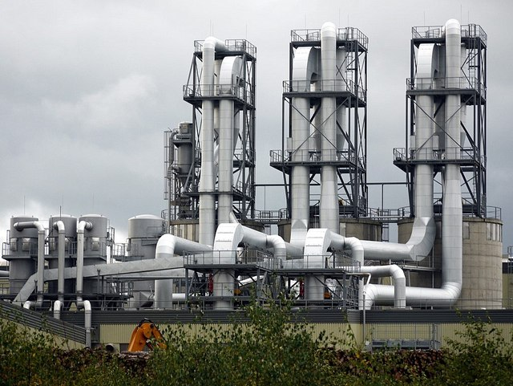
PREFERRED WORKING CAPITAL FOR PROFESSIONALS AND MORE

Slide 24
Preferred Rate Working Capital Loans
For Qualified Industries (Health Care Professionals, CPA, Lawyers, Manufacturing Companies, Restaurants, Automotive Repair, and several other industries
Minimum 640 credit score
Rate as low as 7.5%
Simple Interest Calculation
Semi Monthly Payments

Slide 25



OTHER WORKING CAPITAL
Receivables | Assets
$ 700,000 | $ 500,000

Slide 26
OTHER WORKING CAPITAL LOANS
What do I do if my credit is less than spectacular?
What if I do have a tax lien?
Do I have an option to receive a loan?
The Answer is YES.
DLCC has working capital loans based on your monthly deposits and NOT on your credit. These loans generally have higher interest rates.
DLCC works with the TOP institutions to get you the best deal for your situation.

Slide 27
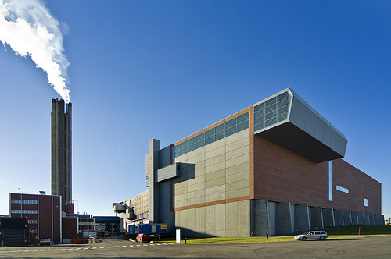
ALTERNATIVE ENERGY LOANS
Alternative Energy Plants.
DLCC works with the top consultants to fund you.
DLCC partners can help you with receiving Government Grants and Low Cost Funding

Slide 28

BUSINESS FUNDING
DLCC can help you fund your project. DLCC can access and evaluate your project to receive Equity or loans for your project as well as SBA Funding or other private financing

Slide 29
LOAN SUMMARY
DLCC is the supermarket for Commercial Lending
DLCC works through a unique and highly experienced network of professionals to get you the best deal DLCC works with the top consultants for funding Alternative Energy Projects
DLCC networks and consults for a private placement equity paperwork and preparation
DLCC has the BEST solutions for Working Capital

Slide 30
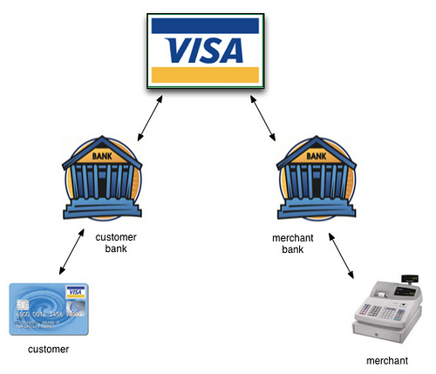
BEST CREDIT CARD PROCESING SOLUTIONS
P
R
O
C
E
S
S
I
N
G

Slide 31

DLCC Merchant Solutions
Credit Card Processing
Most businesses are paying too much for processing
A new law has passed that can virtually ELIMINATE your PROCESSING FEES
Learn more from your agent

Slide 32
MERCHANT CREDIT CARD SOLUTIONS
BEST PRICING GUARANTEED NO LONG TERM CONTRACT:
  INTERCHANGE PLUS: We offer the lowest merchant rates offered. Guaranteed to match or best current pricing.
  CASH DISCOUNT: DLCC through Finical, Inc. can virtually ELIMINATE your processing fees
  TIERED: This pricing structure can reduce fees in many smaller businesses

Slide 33
DLCC CASH DISCOUNT PROGRAM
DLCC through our network partners Finical Inc. and Pivotal Inc., one of the largest credit card processors in North America.
The Cash Discount program is the new Amendment known as the Durbin Amendment.
The purpose of the law is to allow Merchants, large and small, to eliminate merchant processing fees so that Merchants can receive a competitive advantage over places like Walmart

Slide 34
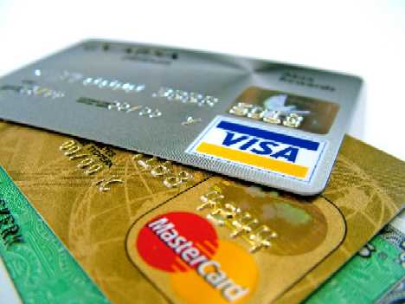
Why Cash Discount?
Interchange Fees are costing Merchants thousands and even millions of dollars every year.
These are the fees charged by the Issuing Banks and Credit Card Companies

Slide 35
Why Cash Discount (continued)
The MOST EXPENSIVE Interchange Fees are CAUSED BY CREDIT CARDS MARKETING the following:
WATCH OUT FOR THE 3 D’s
Rewards Cards: Have you ever received mail saying get 1% cash back? While the customer receives these rewards, who is paying for them (DIVIDENDS)?
Special Tier Cards: These cards are issued to people who cannot receive credit. Have you ever received mail, you just been pre-approved? (DEADBEATS)

Slide 36
CASH DISCOUNT CONTINUED
Bank Reward Cards: Banks now use Reward Visa and MasterCard to give their bank customers “rewards points” to use on merchandise (DEPOSITORIES).
WHY?
Why are YOU paying for customer rewards?
Why are YOU paying for your customers delinquencies?
Why are YOU paying to support THEIR bank?

Slide 37
CASH DISCOUNT PROGRAM
DLCC Through Finical Inc., One of the largest wholesale credit card processors on the West Coast was the first Cash Discount Program after the Durbin Amendment passed.
FINICAL IS THE ONLY COMPANY ALLOWED TO OFFER THIS PROGRAM USING EVERY CREDIT CARD AND IN EVERY STATE!
By the year 2022, it is expected that all businesses will use the cash discount program. Why aren’t YOU?

Slide 38
CASH DISCOUNT PROGRAM
Large Companies currently using Cash Discount
VERIZON (currently in 4 states. To be Nationwide by end of 2018)
MUNICIPAL GOVERNMENTS (Currently in 20 States and expected to in every municipality by 2020)
SHEFFIELD FURNITURE (just expanded to 50% of stores)
OVER 35% OF ALL BUSINESSES HAVE IMPLEMENTED CASH DISCOUNT PROGRAM

Slide 39
INDUSTRIES CURRENTLY USING CASH DISCOUNT PROGRAM
MUNICIPAL GOVERNMENTS
FINE DINING RESTAURANTS
FURNITURE STORES
AUTO REPAIR SHOPS
DRY CLEANERS
GROCERY STORE CHAINS
CELL PHONE INDUSTRY
SERVICE INDUSTRIES

Slide 40
OTHER PROCESING PROCESSING
INTERCHANGE PLUS – This passes the interchange costs directly to the merchant and keeps processing costs low. DLCC does Cost plus 15 bp to 40 bp depending on your industry.
TIERED – This pricing uses a base rate and adds a surcharge for the higher priced cards like Rewards Cards. This is the best solution for most smaller businesses who do less than $ 50,000 a month in volume

Slide 41
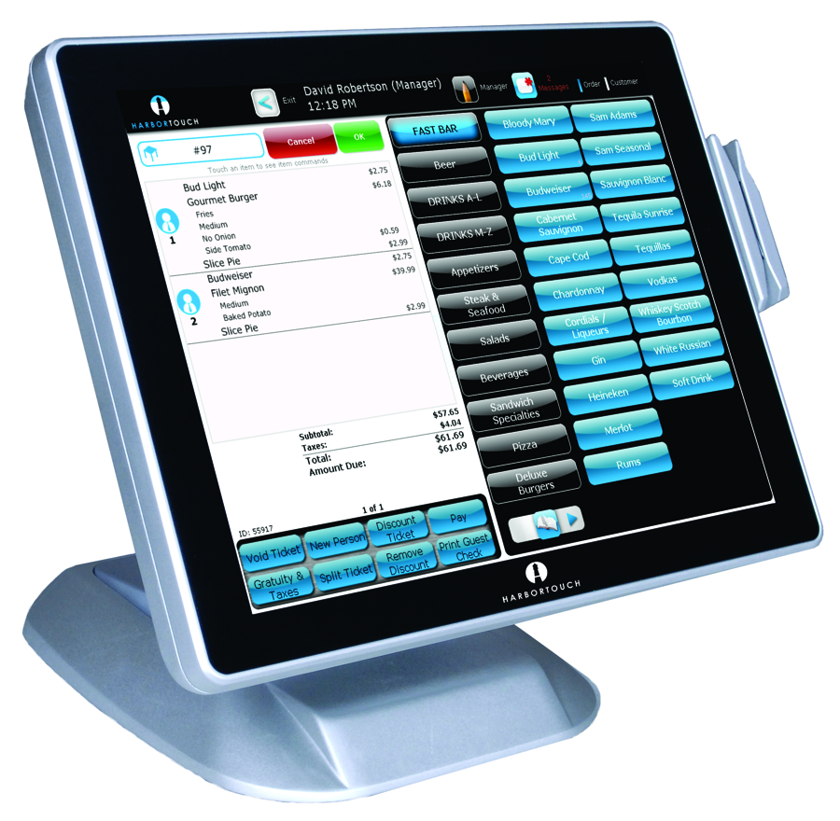
EQUIPMENT AND POS SYSTEMS
THE HARBOURTOUCH SYSTEM

Slide 42
POS SYSTEM
Retail and Restaurants
GET THE NEW HARBORTOUCH SYSTEM FREE
  FREE Installation
  FREE Setup and Pre-Programming
  FREE Customized Programming
  Tablet Based and Newest Compliant Hardware
  RATED #1 RESTAURANT AND RETAIL POS SYSTEM
  Why settle for less when YOU CAN GET THE BEST!

Slide 43
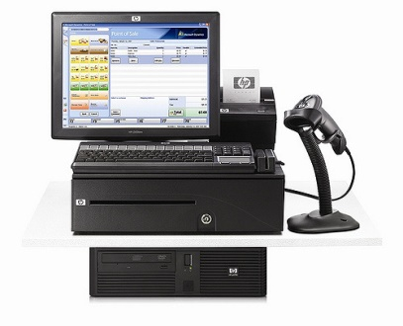
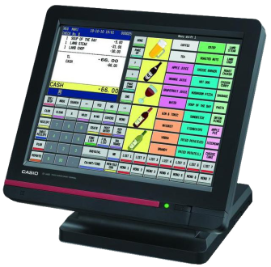
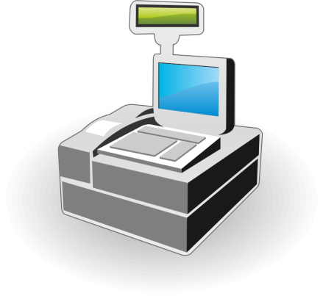
POS SYSTEMS
DLCC is independent and can offer the BEST SOLUTION and EQUIPMENT for your business.
Other POS Systems include: NCR, Shopkeep, and many more depending on your industry and needs

Slide 44
POS SYSTEMS and CARD READERS
Since DLCC is a Wholesaler, DLCC can either lease or sell you equipment at the LOWEST POSSIBLE COST
DLCC will also take pictures of your business to make recommendations on peripheral equipment like printers and monitors
DLCC will set up a FREE DEMO with the company that most meets your needs and work out pricing to get you the best price after the demo and equipment assessment is completed. WE WORK DIRECT!

Slide 45
I CARE
Are you a Dentist, Veterinarian, Chiropractor or other Health Care Professional?
I CARE is the ONLY NON CREDIT BASED financing solution. Now your clients can put down as little as 30% of the cost of major surgeries and finance the rest WITHOUT RISK TO YOU and WITHOUT TURN DOWNS!
I Care can also be used in the Auto Repair Industry as well. SEE IF YOU QUALIFY. ASK FOR PRESENTATION

Slide 46
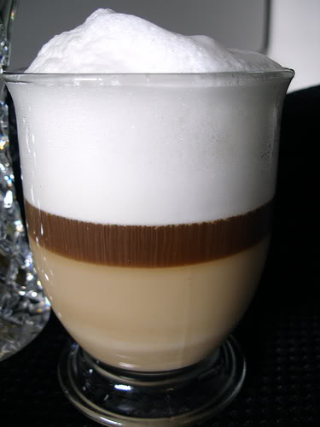
CAPPUCCINO ANYONE?

Slide 47
CAPPUCCINO ANYONE?
Many High End Businesses want to offer a step above other businesses to distinguish themselves as THE BEST and HIGHEST QUALITY.
DLCC through a Partner offers not just a coffee machine but a HIGH END SUPER AUTOMATIC specialty coffee machine.
At one touch make Espresso, Cappuccino, or Latte from REAL WHOLE PREMIUM COFFEE BEANS

Slide 48
DLCC
SOLUTIONS
DLCC helps COMMERCIAL DEVELOPERS to the SMALL BUSINESS MERCHANT
To get the BEST SOLUTIONS at the LOWEST POSSIBLE COST
Developers can start building their project even if a bank cannot help you
DLCC has a network for raising equity with new technology*
Builders have access to working capital
Alternative Energy has access to a whole consulting team to save you millions
Merchants access lower price or ELIMINTATION OF CC PROCESSING FEES
Professionals have access to working capital and patient financing solutions
*Success of equity raise is based on the strength of the project and DLCC offers
No guarantees that your project will fund. DLCC is asked to become a Board Member at 1% to 9%

