Slide 1
The Story
Why?

Slide 2
Who Gets Paid Processing Fees?
Processing Fees – Two Parts
Interchange 80% - 90%
Issuing Banks (Chase, Capital One)
Credit Card Cos. (MC, Visa, D, AMEX)
Processing 10% - 20%
Processors (Pivotal, Heartland)
Digital Systems (TSYS, HDM)

Slide 3
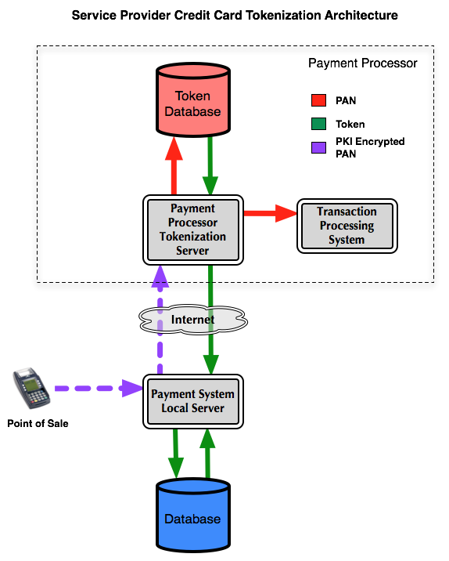
Processor Fees Explained (10%)
The Processor

Slide 4
The Agent (part of the 10%)
Works for $5.00 to $10.00 a month
I can save you 20% on your processing…
I HATE YOU GUYS! I AM BUSY AND NOT INTERESTED

Slide 5
Interchange Fees Explained (90%)
Interchange Fees PAY THE 3 D’s
Bank Execs Bank Buildings Your Friendly Banker
DEPOSITORIES

Slide 6
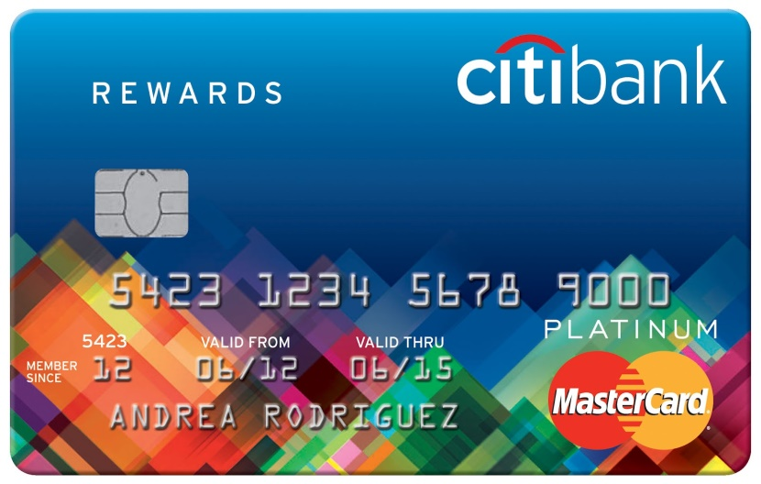
Interchange Fees Continued
Interchange Rewards Cards
This is GREAT. I just keep charging and the stores pay me to go on vacation twice a year.
DIVIDENDS

Slide 7
THE FINAL INTERCHANGE FEE
Collections on bad accounts
Hey George can you believe How do I get one?
The bank gave ME a Credit Card? Johnboy?
SIMPLE: Just get a PO BOX AND THE BANK WILL PRE APPROVE YOU
DEADBEATS

Slide 8
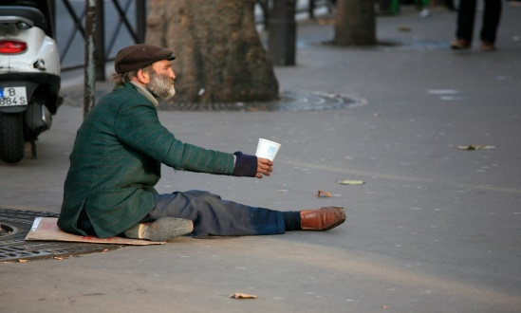
WHO SHOULD PAY THESE FEES?
The Merchant or The Customer?

Slide 9
Ask yourself these questions
Do your customers invite you to share their rewards?
Should I be forced to pay for clients who do not pay their bills?
IF THE ANSWER IS NOBODY AND NO THEN PAY ATTENTION

Slide 10
NEW LAW
FOR CERTAIN QUALIFIED BUSINESSES YOU CAN NOW PASS THROUGH THOSE FEES AND YOU NO LONGER HAVE TO PAY THEM YOURSELF!
The Program is called: CASH DISCOUNT
The Bottom LINE…

Slide 11
A Typical Invoice
Parts (or food) $30.00
Labor $20.00
Sub Total $50.00
T $ 3.25
C $ 2.00
Tip $ _____
Total $ 55.25

Slide 12
What just happened
The customer accepted the cash discount.
All bills will add the total with a fixed percentage assuming they pay with a credit card.
If they choose to pay with cash…GIVE THEM A 4% DISCOUNT. If they choose to pay credit card….do nothing but let them pay. The machine will AUTOMATICALLY DEFAULT TO INCLUDE THE INTERCHANGE FEES.

Slide 13
How will clients react?
90% of customers JUST PAY THE BILL. They already assume this is like a tax or other charge nobody has control over. You NOW already pay a “soda pop tax” and a “eat in tax” in many stores. The key is THIS AMOUNT IS NOT SIGNIFICANT!
What about the customer who asks….

Slide 14
What to say?
We NOW offer a cash discount. This fee is waived for paying cash.
Most will JUST SAY OKAY and PAY THE BILL.
If someone had a bad dinner…what do you do? Same thing here…
Mr. customer….we value your business so I will waive the fee this time (push the special button)…PROBLEM SOLVED

Slide 15
What THIS MEANS TO YOU!
Merchant Volume | Merchant Fees | Net to Merchant |  | Merchant Volume (with CD) | Fees Total | Net to Merchant
20,000 | $ 500 | $19,500 |  | $ 20,700 | $ 850 | $19.950
50,000 | $ 1,100 | $48,900 |  | $ 51,800 | $2,100 | $49,700
SAVINGS TO MERCHANT | $20,000 _________ | 19850 -19500 $ 350 |  | $50,000 MONTHLY | 49700 -48900 $ 800 | MONTHLY
BEFORE AFTER
This includes ALL EXPENSES FEES BATCH STATEMENT AND EVERYTHING!
What will you do with an extra $4,000 to $10,000 a
year?

Slide 16
THE DEAL
WE GUARANTEE THIS WILL WORK
We will put you on a month to month program.
IF WE DO NOT ADD MONEY TO YOUR POCKET WE GUARANTEE TO SWITCH YOU BACK AT THE SAME OR LOWER PROCESSING FEE YOU ORIGIANLLY HAD!
NO RISK TO YOU!
(Sign up will only take about 5 min)

