Slide 1
DirectLink Capital Corporation
Dental Professional Program

Slide 2
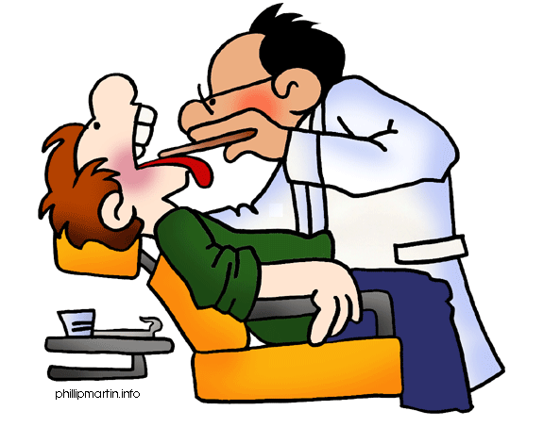
Dentistry is Changing

Slide 3
Introduction
A four part program developed by a financial professional with 40 years experience in the industry
Mr. Goodman is the son of a famous Dental Family in Ohio who understands how important dental care is to EVERYONE!
DLCC understands several needs of a dental practice in the 21st Century:
Need for Patient Financing
Low cost or no cost* credit card processing

Slide 4
Introduction (Continued)
Preferred Rate Working Capital Program to be able to expand their practice, purchase new equipment or purchase another existing practice.
Access to immediate cash without having to finance. This is known as A/R Factoring (Non-Recourse)
DLCC did not create any of these financial products. DLCC took four of the best financial products and made them better!

Slide 5
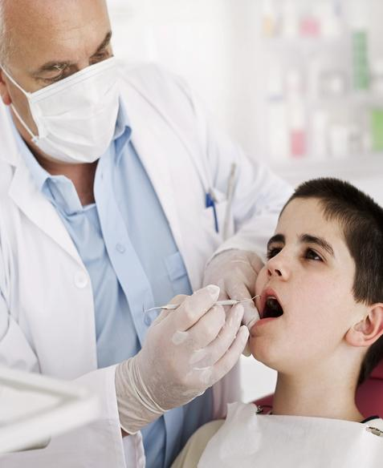
Part 1
Financing your Patients WITH NO CREDIT CHECK!
Going to the Dentist is scary enough. A patient wants peace of mind without going broke.
Dentists want to give
Quality care WITHOUT
Being a BANK!

Slide 6
Part 1
Imagine giving a patient INSTANT FINANCING WITHOUT ANY CREDIT CHECK?
This program can work as a complement to Care Credit
Our network partner has more than 5000 dental practices across the USA participating
Your revenues should increase AT LEAST $80,000 A YEAR!

Slide 7
How does it work?
Patient must have a photo ID and Debit Card.
Your office person inserts them into the system
Patient pays a 30% of the procedure with their debit card (ask about flexibility)
The dental practice is now guaranteed to receive the FULL AMOUNT of the patients payments WITHOUT RECOURSE
Setup and approval takes about 5 minutes
A walk in patient could be seen that day

Slide 8
Never Turn a Patient Away!

Slide 9
How can I take advantage of this program?
We ask that all dentists partake in a 10 minute presentation on the internet.
This presentation will show the complete program
Also covered:
How your practice will grow from $80,000 to $350,000 annually (see testimonials)
The cost for program setup
Patient application and “0 interest” payments
User Friendly software and staff training
Ongoing servicing for your patients
NEVER TURN A PATIENT AWAY!

Slide 10
One Happy Family
Truly AFFORDABLE Dental Care

Slide 11
One Happy Dental Practice

Slide 12
Testimonials (more upon request)
Breezy Dental
Schaumberg Dental Studios
Bertrand A Bonnick DDS
Dr Duongvannak Keo DMD
Kanning Dental
Austin Dental Implant Center
North Mesquite Dental Group
Ala Moana Dental Center
Marty Lipsey DDS

Slide 13
Part 2
Lower Processing Costs
DLCC is networked with the lowest cost wholesaler in the Processing Industry
A Dentist who partakes in our total solution package, will receive the following:
Lowest cost Credit Card Processing Guaranteed done on a month to month (no long term contracts) basis
Free Equipment as long as you process through our company.

Slide 14
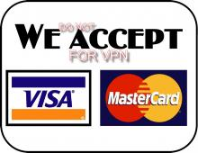
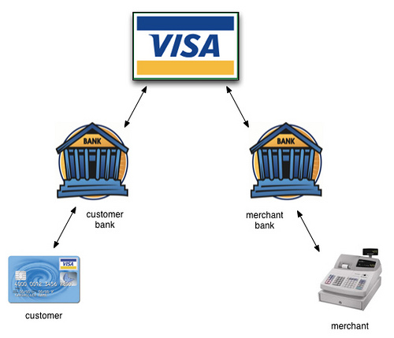
Make Processing Simpler and Less Expensive (Wholesale Rates)
Partnership between Finical and Pivotal, the largest Merchant Bank in North America. DLCC works with both.

Slide 15
Part 3
Preferred Financing for Dentists
Single dental practices are being phased out over the next 10 years
DLCC has the solution to finance a new practice, expand your current practice, or even begin franchising
DLCC will provide access to our Preferred Rate Working Capital Loans (Simple Interest)
DLCC offers other unique financing solutions

Slide 16
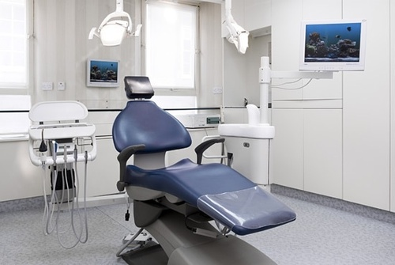
Competitive Edge
I would LOVE to get new updated equipment

Slide 17
Starting a Clinic Franchise?
This seems complicated

Slide 18
DLCC will simplify
And Help you GROW!

Slide 19
This is the New Wave of Dentistry
Bigger Financial Resources means Bigger Profits

Slide 20
Summary
Instant financing for your patients with NO CREDIT CHECK and NON RECOURSE
Lower Credit Card Rates. DLCC can save you as much as 50%. Also Free Equipment and month to month contract
Preferred Rate Financing for Working Capital Access for your Practice
Special Factoring Rates for additional access to immediate capital

Slide 21
How do I get Started?
Call me or DLCC (330) 502-6745 to get set up for your 10 minute I Care Presentation.
Once completed DLCC will get your I Care program started.
Also we will get your current processing changed over.
If you currently have Care Credit we will insert a free machine to lower your processing costs. Most use a “dual system”.
If not, we can do a free install and lower your processing costs. Please show us a statement.

Slide 22
Smile with DLCC!

