Slide 1
DIRECTLINK CAPITAL CORPORATION

Slide 2
DIRECTLINK CAPITAL CORPORATION
Empowering the BEST and MOST INNOVATIVE products and ideas to Commercial Borrowers and Merchants

Slide 3
Meet the Team
Keith Goodman and Eva Salsbury Co-Founders Sr. VP and Secretary
Keith Goodman and Eva Salsbury founded DLCC in 2012. Mr. Goodman spent most of his 40+ years in the Financial Industry. Mr. Goodman began his professional career at Beneficial Finance. After two years moved into dealer and commercial financing for ITT.
In 1984 Mr. Goodman started in Financial planning and investment banking lasting more than 25 years. Most of this time was with Wachovia (now Wells Fargo) as Vice President. Mr. Goodman worked with many HNW individuals and institutions.

Slide 4
Meet the Team
Stephen Tharp – CFO and Co-Founder
Mr. Tharp, a graduate of Ohio State University spent most of his life in the financial and insurance industries.
Stephen Tharp worked for several years in HR and Employee Relations.

Slide 5
Key Members
Randy King – Vice President
Randy is primarily responsible for loan qualification and pre-underwriting as well as packaging. Randy worked for Edward Jones and also owned an insurance company. Randy has been an integral part of the growth of DLCC
Jeff Witt and Tom Koltonsky – Commercial Lending Expert
Jeff is primarily responsible for the growth of our lending and equity partners with major qualified real estate developers. DLCC has several networks that allows qualified clients to receive as much as 80% to 100% debt / private equity funding on larger projects.

Slide 6
Key Staff Members and Affiliates
Mark Belinky – Internal Legal for Equity PPM and Portal Management
Mark’s legal career extends more than 30 years including probate judge
Craig Evans – President American Diversified Energy.
Craig is our primary consulting source for Alternative Energy Projects and obtaining Grants and Capital
Glenn and Stacey Johnson –
Glenn is responsible for our recruiting and personnel.
Glenn has more than 40 years experience in Recruiting

Slide 7
DLCC Account Executives
Jeff Witt (Cleveland OH)
Sheila Harrison (Bowling Green Ky)
Don Carlson (Akron OH)
Melissa James (St. Louis MO)
Robin Fry (Pittsburgh PA)
Susan Maola (Sharon PA)
Donna Rutherford (Omaha NE)
Alex Kline (Las Vegas NV)
Shelley Battenfield (Cincinnati OH)
Daniel Bennett (Blackshear and Atlanta GA)
Brian Kochunas (Youngstown and Warren OH)

Slide 8
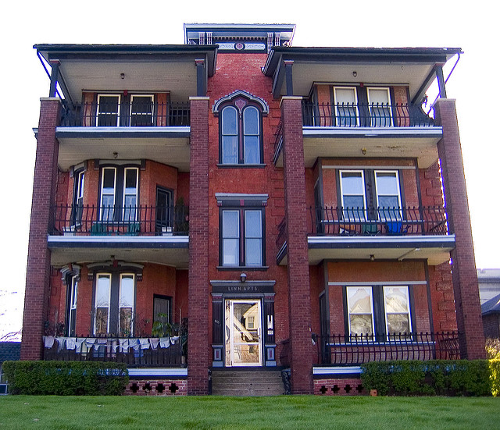
COMMERCIAL REAL ESTATE LOANS
Multi Family Project Special Rates

Slide 9
MULTI FAMILY SPECIALS
Non- Recourse
Multi Family Special (up to 15% mixed use allowed)
Current Rate* 4.375% (plus .65% PMI)
In most cases 85% LTV
35 Years Amortization
Uses include REFI, New Construction, Purchase
Bridge Loans Available to start project earlier

Slide 10
Multi Family Housing Financing
HUD Loan with 75% or more assistance
90% LTV or LTC
Purpose is New Construction and Limited Scope
Rate 4.25% (subject to change)
Non- Recourse
40 Year Amortization

Slide 11
Non HUD or FHA Financing for Acquisition and Refinance
Non HUD or FHA Financing
Current rate 4.6%
80% LTV or LTC
Non-Recourse
Not limited to Multi-Family
May qualify for some mixed use Real Estate
Other loans with flexible terms available
3 to 7 year with 30 year Amortization

Slide 12
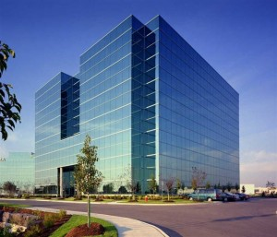
DLCC COMMERCIAL FINANCING

Slide 13
DLCC COMMERCIAL LENDING
DLCC connects borrowers through a network of more than 1000 lenders.
These lenders include special bank financing
Insurance companies
Private Hedge Funds
Other Non-Conventional Financing

Slide 14
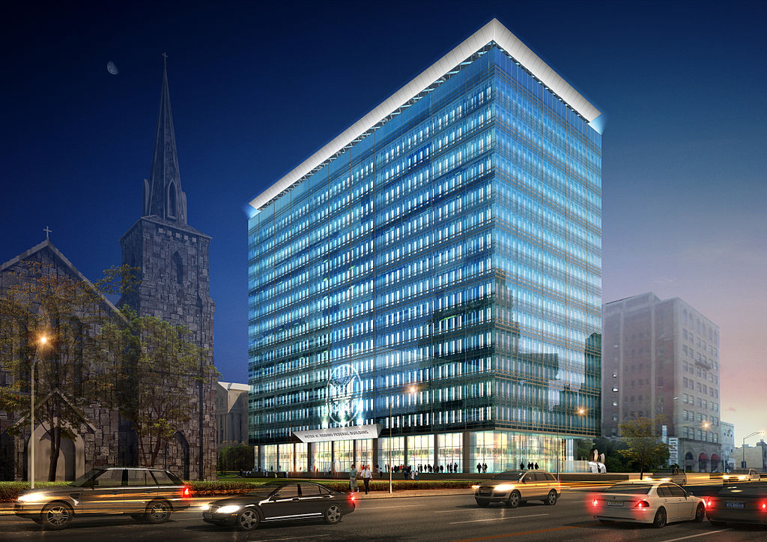
DLCC Real Estate Financing
Office Buildings

Slide 15
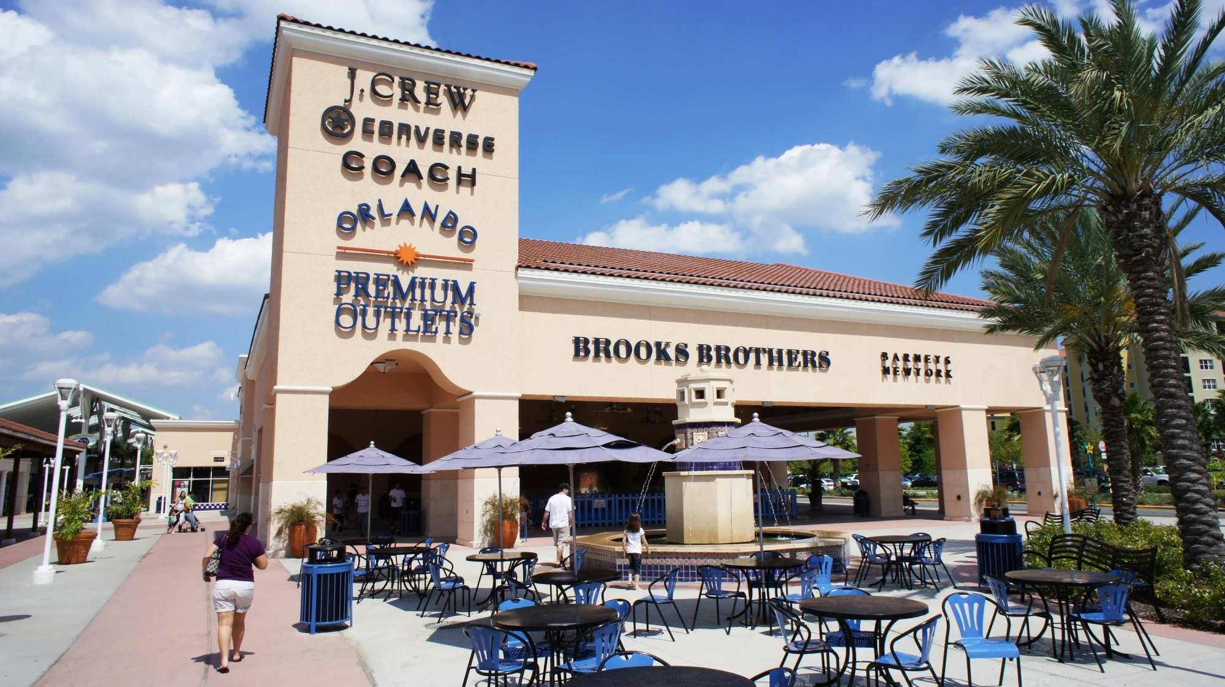
DLCC Real Estate Financing
Retail Strip Centers and Outlet Stores

Slide 16
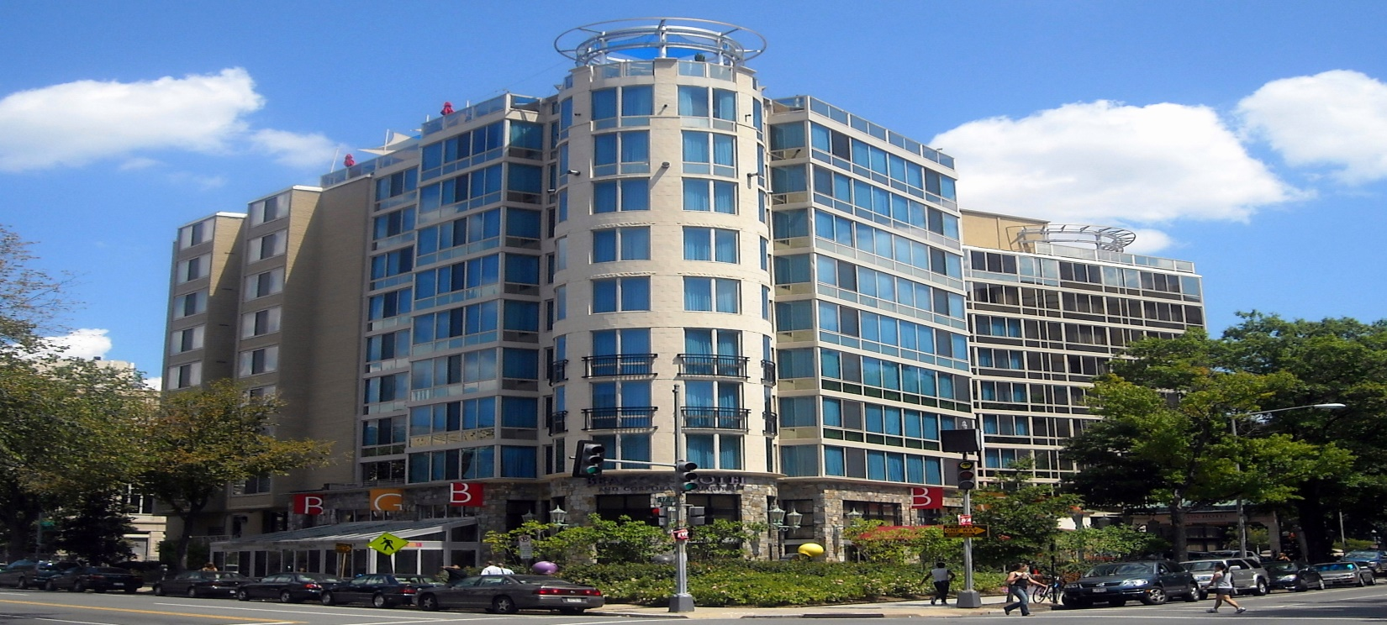
DLCC Commercial Financing
Hotels

Slide 17
WORKING CAPITAL LOANS

Slide 18
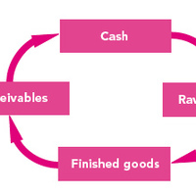
WORKING CAPITAL USES

Slide 19
Purpose of Working Capital Loans
Pay off Debt
Payroll
Marketing and Advertising
Equipment Purchase
General Expenses
Cover Slow Months
Inventory Purchase* (Limited to certain industries)

Slide 20
DLCC SBA Working Capital Loans
NEW SBA Working Capital Loans
DLCC though our partners are able to provide an SBA Working Capital loan for your needs less expensive than other choices of working capital loans. DLCC has the most unique online process.
Pre-qualification process takes 15 minutes (5 minutes for answer) PRE-QUALIFY NOW

Slide 21
NEW SBA Working Capital Loans
Minimum 650 credit score, no delinquencies, 2+ years in business, no tax liens or criminal record
7% (8.53% including fees) Rate. 8% on smaller amounts
Payment on $100,000 is $1,162 per month
Payoff your high interest working capital loan
No prepayment penalty
Requirements can be discussed with our qualified agents

Slide 22
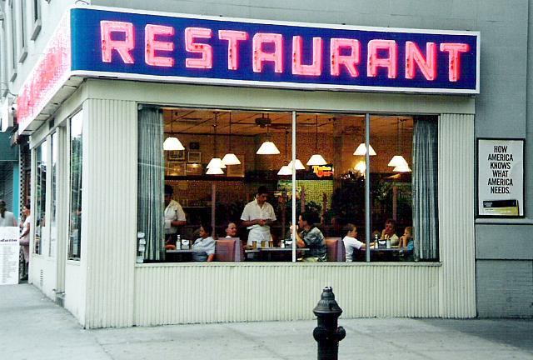
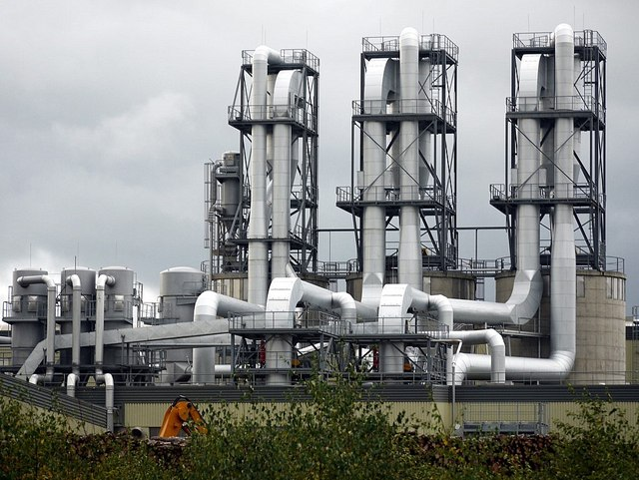
PREFERRED WORKING CAPITAL FOR PROFESSIONALS AND MORE

Slide 23
Preferred Rate Working Capital Loans
For Qualified Industries (Health Care Professionals, CPA, Lawyers, Manufacturing Companies, Restaurants, Automotive Repair, and several other industries
Minimum 640 credit score
Rate as low as 7.5%
Simple Interest Calculation
Semi Monthly Payments

Slide 24
OTHER WORKING CAPITAL
Receivables | Assets
$ 700,000 | $ 500,000

Slide 25
OTHER WORKING CAPITAL LOANS
What do I do if my credit is less than spectacular?
What if I do have a tax lien?
Do I have an option to receive a loan?
The Answer is YES.
DLCC has working capital loans based on your monthly deposits and NOT on your credit. These loans generally have higher interest rates.
DLCC works with the TOP institutions to get you the best deal for your situation.

Slide 26
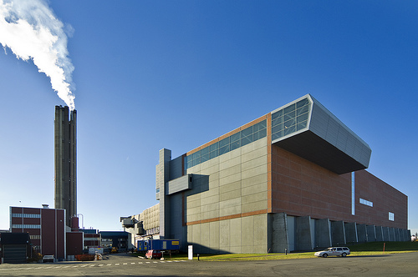
ALTERNATIVE ENERGY LOANS
Alternative Energy Plants.
DLCC works with the top consultants to fund you.
DLCC partners can help you with receiving Government Grants and Low Cost Funding

Slide 27
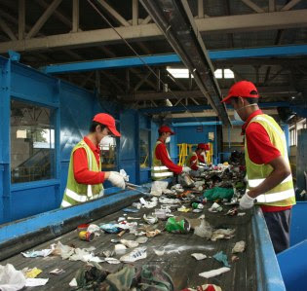
BUSINESS FUNDING
DLCC can help you fund your project. DLCC can access and evaluate your project to receive Equity or loans for your project as well as SBA Funding or other private financing

Slide 28
LOAN SUMMARY
DLCC is the supermarket for Commercial Lending
DLCC works through a unique and highly experienced network of professionals to get you the best deal DLCC works with the top consultants for funding Alternative Energy Projects
DLCC networks and consults for a private placement equity paperwork and preparation
DLCC has the BEST solutions for Working Capital

Slide 29
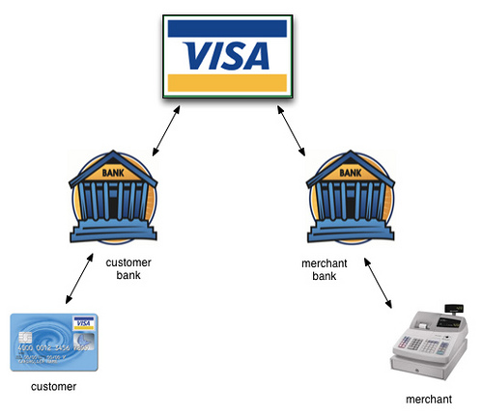
BEST CREDIT CARD PROCESING SOLUTIONS
P
R O C E S S I N G

Slide 30
DLCC Merchant Solutions
Credit Card Processing
Most businesses are paying too much for processing
A new law has passed that can virtually ELIMINATE your PROCESSING FEES
Learn more from your agent

Slide 31
MERCHANT CREDIT CARD SOLUTIONS
BEST PRICING GUARANTEED NO LONG TERM CONTRACT:
INTERCHANGE PLUS: We offer the lowest merchant rates offered. Guaranteed to match or best current pricing.
CASH DISCOUNT: DLCC through Finical, Inc. can virtually ELIMINATE your processing fees
TIERED: This pricing structure can reduce fees in many smaller businesses

Slide 32
DLCC CASH DISCOUNT PROGRAM
DLCC through our network partners Finical Inc. and Pivotal Inc., one of the largest credit card processors in North America.
The Cash Discount program is the new Amendment known as the Durbin Amendment.
The purpose of the law is to allow Merchants, large and small, to eliminate merchant processing fees so that Merchants can receive a competitive advantage over places like Walmart

Slide 33
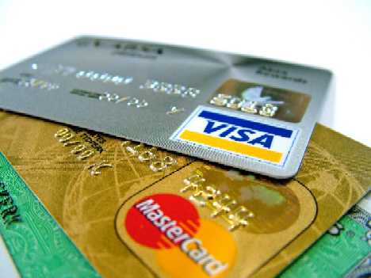
Why Cash Discount?
Interchange Fees are costing Merchants thousands and even millions of dollars every year.
These are the fees charged by the Issuing Banks and Credit Card Companies

Slide 34
Why Cash Discount (continued)
The MOST EXPENSIVE Interchange Fees are CAUSED BY CREDIT CARDS MARKETING the following:
WATCH OUT FOR THE 3 D’s
Rewards Cards: Have you ever received mail saying get 1% cash back? While the customer receives these rewards, who is paying for them (DIVIDENDS)?
Special Tier Cards: These cards are issued to people who cannot receive credit. Have you ever received mail, you just been pre-approved? (DEADBEATS)

Slide 35
CASH DISCOUNT CONTINUED
Bank Reward Cards: Banks now use Reward Visa and MasterCard to give their bank customers “rewards points” to use on merchandise (DEPOSITORIES).
WHY?
Why are YOU paying for customer rewards?
Why are YOU paying for your customers delinquencies?
Why are YOU paying to support THEIR bank?

Slide 36
CASH DISCOUNT PROGRAM
DLCC Through Finical Inc., One of the largest wholesale credit card processors on the West Coast was the first Cash Discount Program after the Durbin Amendment passed.
FINICAL IS THE ONLY COMPANY ALLOWED TO OFFER THIS PROGRAM USING EVERY CREDIT CARD AND IN EVERY STATE!
By the year 2022, it is expected that all businesses will use the cash discount program. Why aren’t YOU?

Slide 37
CASH DISCOUNT PROGRAM
Large Companies currently using Cash Discount
VERIZON (currently in 4 states. To be Nationwide by end of 2018)
MUNICIPAL GOVERNMENTS (Currently in 20 States and expected to in every municipality by 2020)
SHEFFIELD FURNITURE (just expanded to 50% of stores)
OVER 35% OF ALL BUSINESSES HAVE IMPLEMENTED CASH DISCOUNT PROGRAM

Slide 38
INDUSTRIES CURRENTLY USING CASH DISCOUNT PROGRAM
MUNICIPAL GOVERNMENTS
FINE DINING RESTAURANTS
FURNITURE STORES
AUTO REPAIR SHOPS
DRY CLEANERS
GROCERY STORE CHAINS
CELL PHONE INDUSTRY
SERVICE INDUSTRIES

Slide 39
OTHER PROCESING PROCESSING
INTERCHANGE PLUS – This passes the interchange costs directly to the merchant and keeps processing costs low. DLCC does Cost plus 15 bp to 40 bp depending on your industry.
TIERED – This pricing uses a base rate and adds a surcharge for the higher priced cards like Rewards Cards. This is the best solution for most smaller businesses who do less than $ 50,000 a month in volume

Slide 40
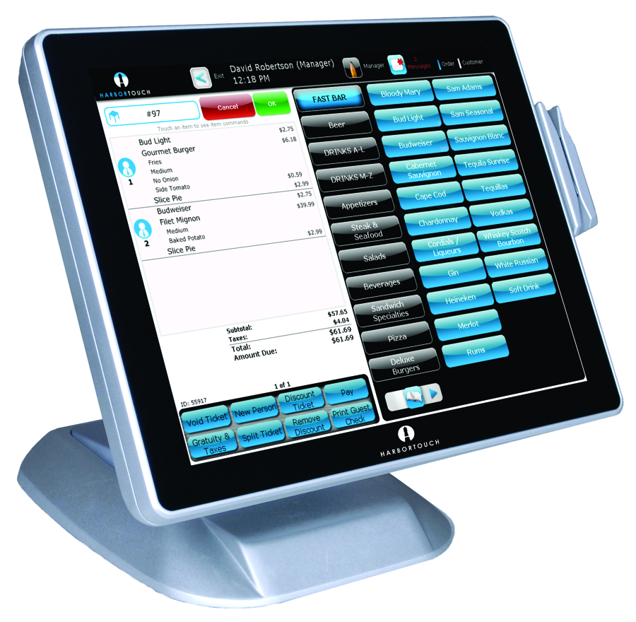
EQUIPMENT AND POS SYSTEMS
THE HARBOURTOUCH SYSTEM

Slide 41
POS SYSTEM
Retail and Restaurants
GET THE NEW HARBORTOUCH SYSTEM FREE
FREE Installation
FREE Setup and Pre-Programming
FREE Customized Programming
Tablet Based and Newest Compliant Hardware
RATED #1 RESTAURANT AND RETAIL POS SYSTEM
Why settle for less when YOU CAN GET THE BEST!

Slide 42
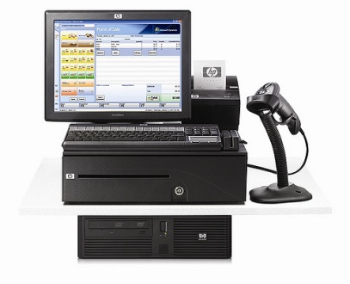
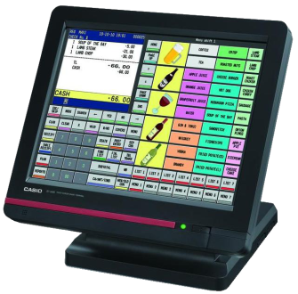
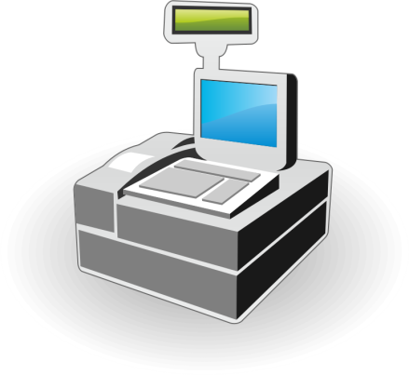
POS SYSTEMS
DLCC is independent and can offer the BEST SOLUTION and EQUIPMENT for your business.
Other POS Systems include: NCR, Shopkeep, and many more depending on your industry and needs

Slide 43
POS SYSTEMS and CARD READERS
Since DLCC is a Wholesaler, DLCC can either lease or sell you equipment at the LOWEST POSSIBLE COST
DLCC will also take pictures of your business to make recommendations on peripheral equipment like printers and monitors
DLCC will set up a FREE DEMO with the company that most meets your needs and work out pricing to get you the best price after the demo and equipment assessment is completed. WE WORK DIRECT!

Slide 44
I CARE
Are you a Dentist, Veterinarian, Chiropractor or other Health Care Professional?
I CARE is the ONLY NON CREDIT BASED financing solution. Now your clients can put down as little as 30% of the cost of major surgeries and finance the rest WITHOUT RISK TO YOU and WITHOUT TURN DOWNS!
I Care can also be used in the Auto Repair Industry as well. SEE IF YOU QUALIFY. ASK FOR PRESENTATION

Slide 45
DLCC
SOLUTIONS
DLCC helps COMMERCIAL DEVELOPERS to the SMALL BUSINESS MERCHANT
To get the BEST SOLUTIONS at the LOWEST POSSIBLE COST
Developers can start building their project even if a bank cannot help you
DLCC has a network for raising equity with new technology*
Builders have access to working capital
Alternative Energy has access to a whole consulting team to save you millions
Merchants access lower price or ELIMINTATION OF CC PROCESSING FEES
Professionals have access to working capital and patient financing solutions
*Success of equity raise is based on the strength of the project and DLCC offers
No guarantees that your project will fund. DLCC is asked to become a Board Member at 1% to 9%

